Slide 1

Telecom Churn Case Study
Submitted by
Naveen M
Namrata Kumari
Shourie naga

Slide 2
Problem Statement
In the telecom industry, customers are able to choose from multiple service providers and actively switch from one operator to another. In this highly competitive market, the telecommunications industry experiences an average of 15-25% annual churn rate. Given the fact that it costs 5-10 times more to acquire a new customer than to retain an existing one, customer retention has now become even more important than customer acquisition.
For many incumbent operators, retaining high profitable customers is the number one business goal.
To reduce customer churn, telecom companies need to predict which customers are at high risk of churn.
In this project, we will analyse customer-level data of a leading telecom firm, build predictive models to identify customers at high risk of churn and identify the main indicators of churn.

Slide 3
Project Objective
To predict Customer Churn
Highlighting the main variables/factors influencing Customer Churn
Use various ML algorithms to build prediction models, evaluate the accuracy and performance of these models.
Finding out the best model for our business case and providing executive suggestions.

Slide 4
Model Building Steps
Data collection
Data preparation
Perform EDA
Feature selection
Building models
Validate and measure models performance
Improve models performances
Executive models for prediction
Select best fit model for our business problem

Slide 5
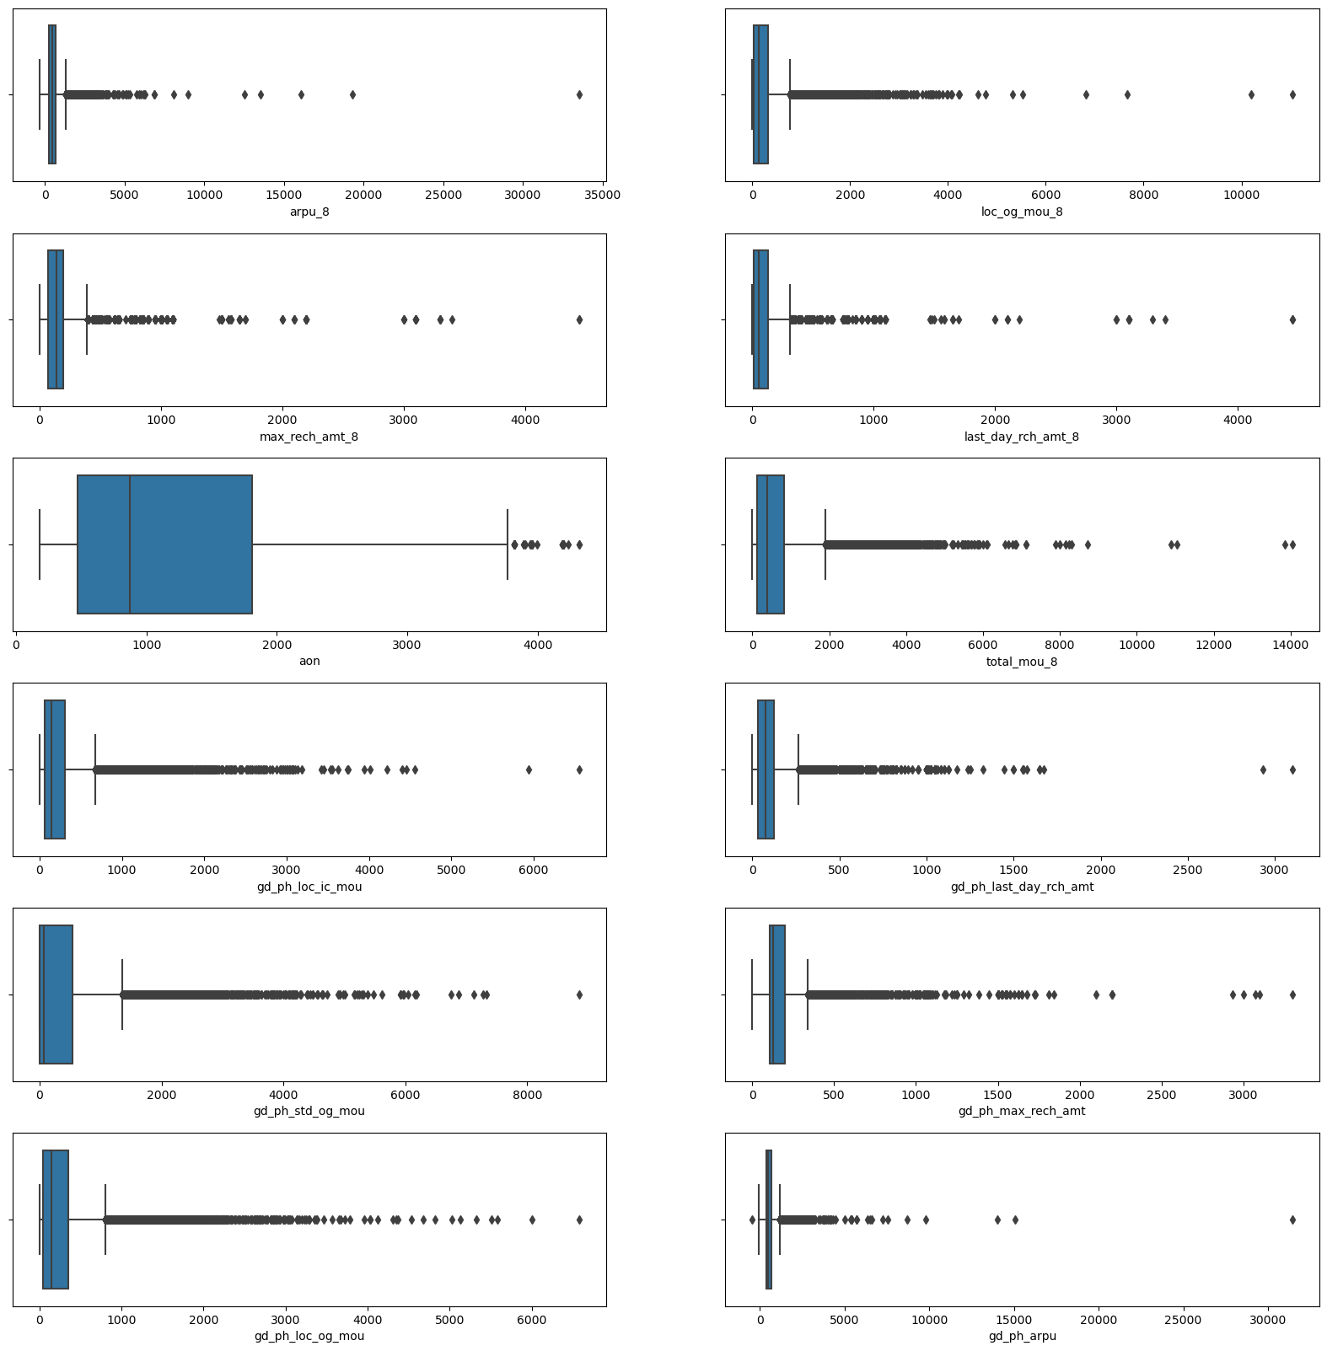
EDA
From plots we can define following upper limits to the variables
Feature Value arpu_8 7000 loc_og_mou_8 4000 max_rech_amt_8 1000 last_day_rch_amt_8 1000 aon 3000 total_mou_8 4000 gd_ph_loc_ic_mou 3000 gd_ph_last_day_rch_amt 1000 gd_ph_std_og_mou 4000 gd_ph_max_rch_amt 1500 gd_ph_loc_og_mou 3000 gd_ph_arpu 7000

Slide 6
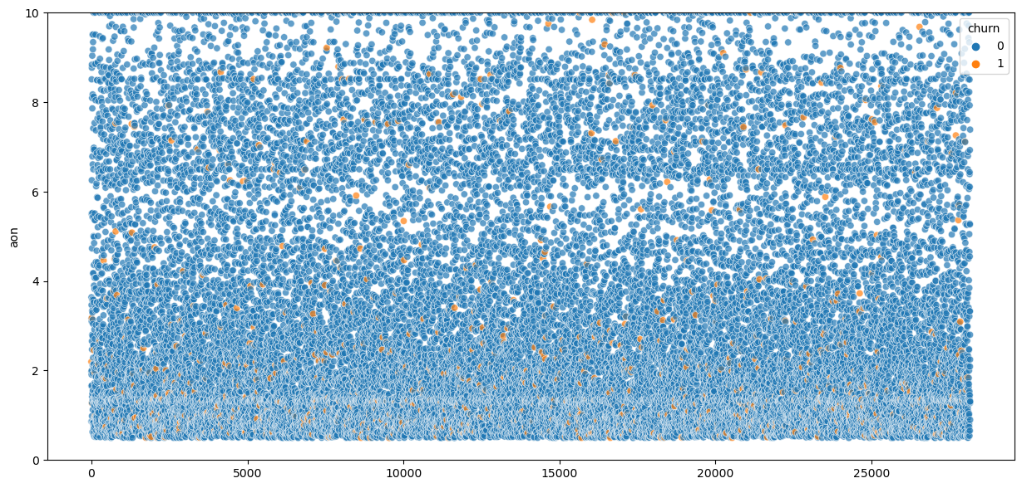
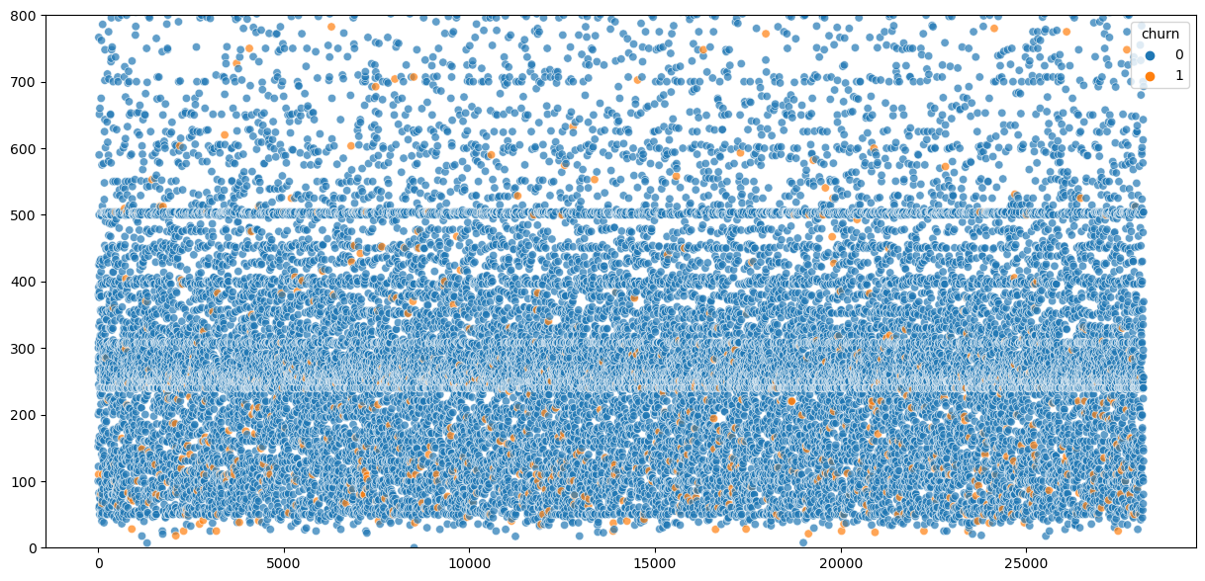
Churn based on tenure
Effect of max recharge amount on churn
Insights:
As we can see that most of the churners have a tenure less than 4 years
Insights:
As we can observe users having the max recharge amount less tha 250 churned more.

Slide 7
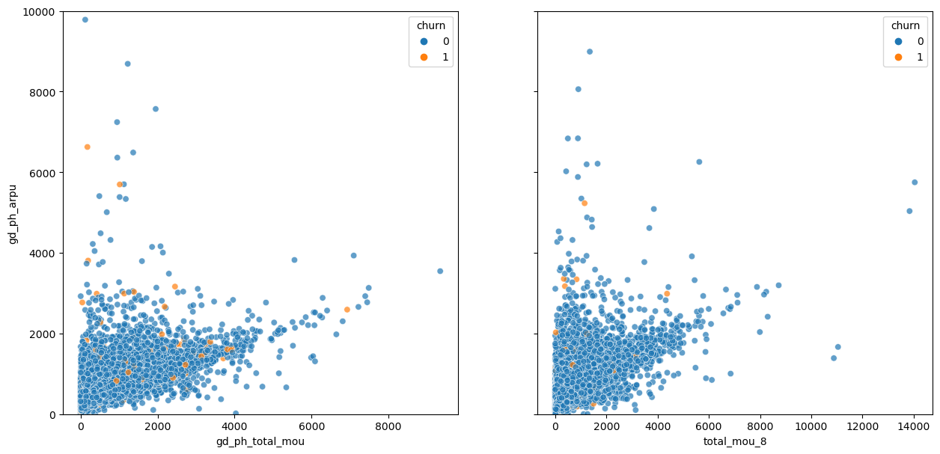
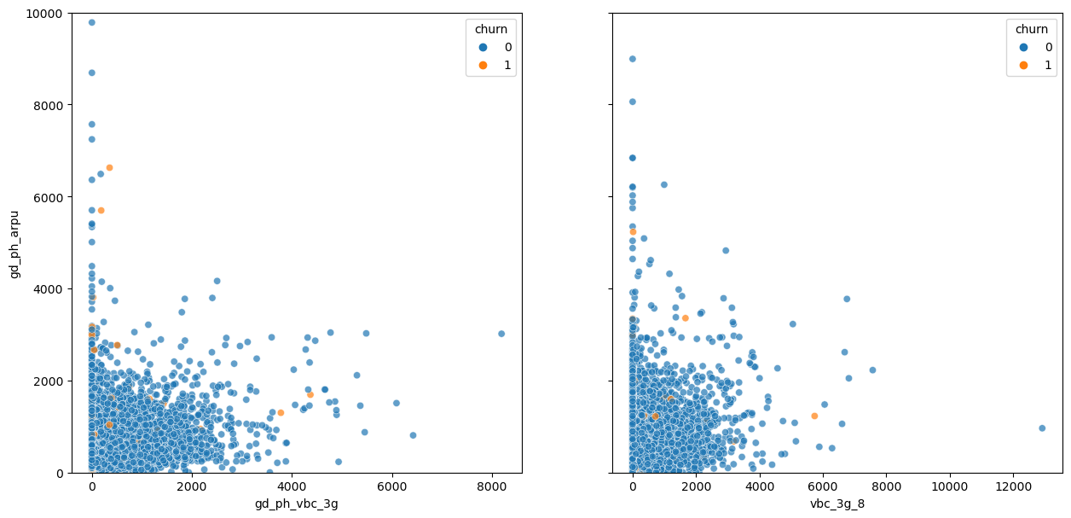
VBC effects on revenue
total_mou effects on revenue
Insights:
As we can observe that MOU is dropping significantly for churners in action phase which hitting the revenue generation. But then also revenue is higher in that part which indicates that the users are taking other services which increasing the revenue generation.
Insights:
As we can see users using less amount of VBC generating high revenue churned and also revenue is higher from less consumption part.

Slide 8
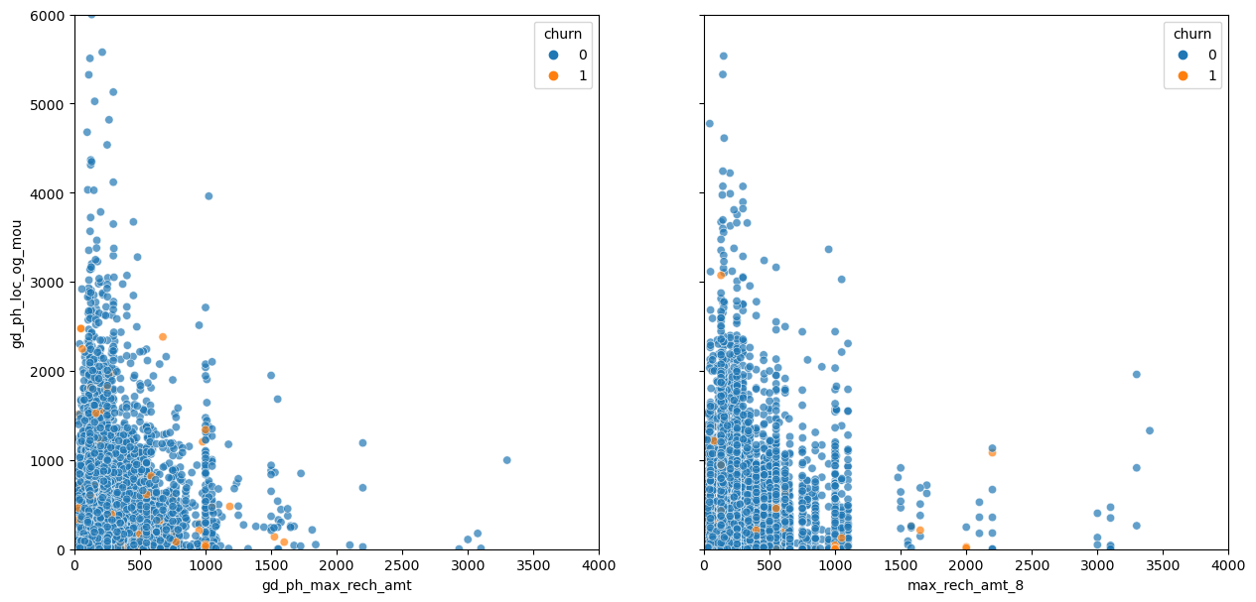
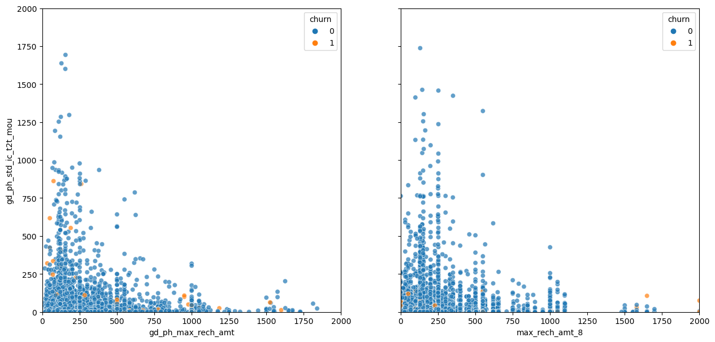
Recharge amount vs local outgoing calls
Same service provider vs the recharge amount
Insights:
As we can see users recharging with high amounts using less local services in compare to users recharging with less amount. And users having max recharge amount as well as local out going were very less even in the good phase churned more.
Insights:
As we can observe users having max recharge amount on the higher end and low incoming call mou during the good pahse churned more

Slide 9
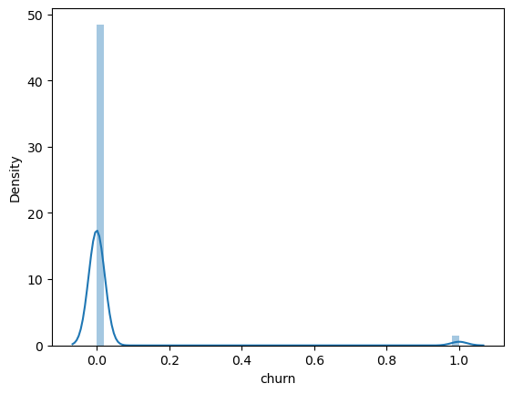
Distribution of target variable
Insights:
As we can see that it is not skewed but highly imbalanced. The number of non churners are vwery high. so we will handle this using SMOTE.

Slide 10
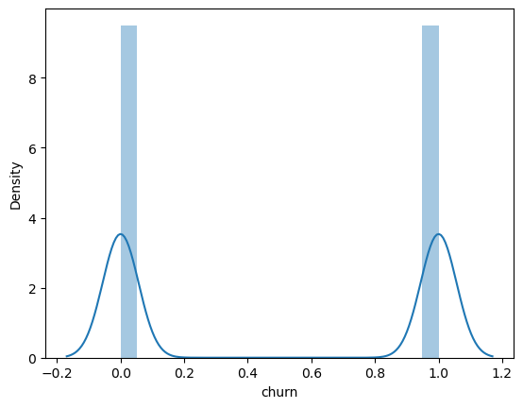
Handling class imbalance using SMOTE

Slide 11
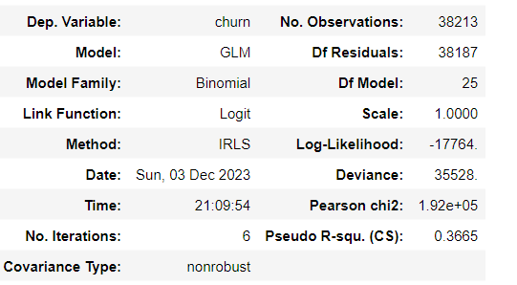
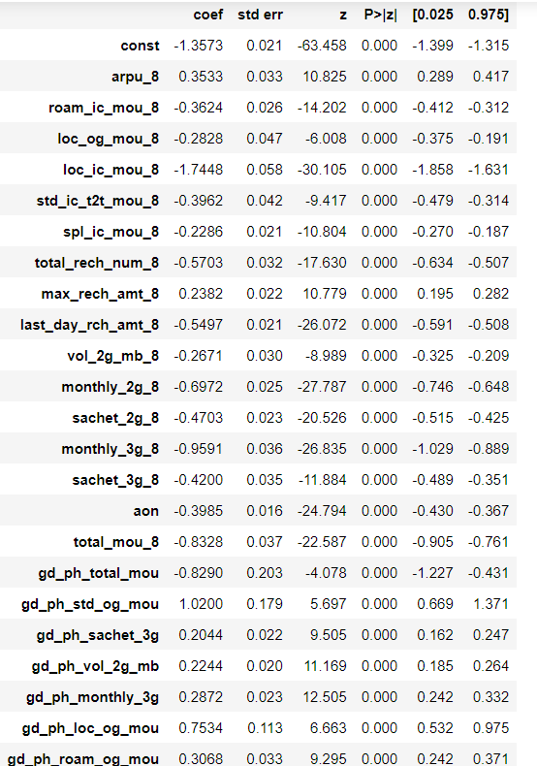
Model Building
1. Logistic Regression using RFE

Slide 12
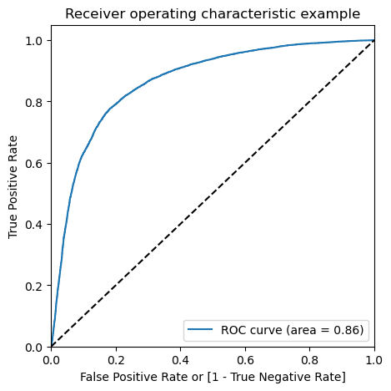
ROC Plotting

Slide 13
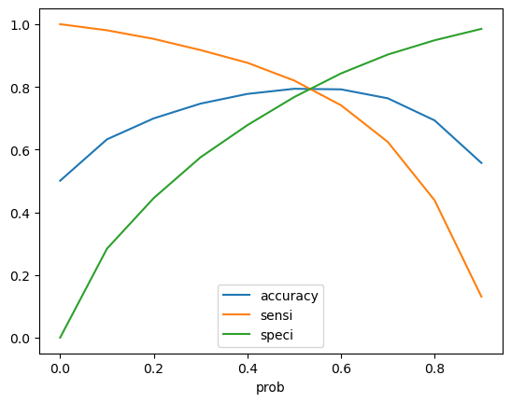
Optimal Cutoff
As we can see optimal cutoff is 0.5 so we will keep it

Slide 14
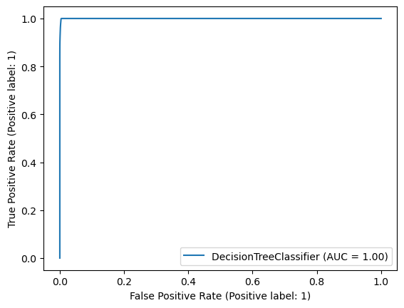
Decision Tree
ROC curve using hyperparameter tunning
Insights:
With Decision Tree, we are getting 90% accuracy.

Slide 15
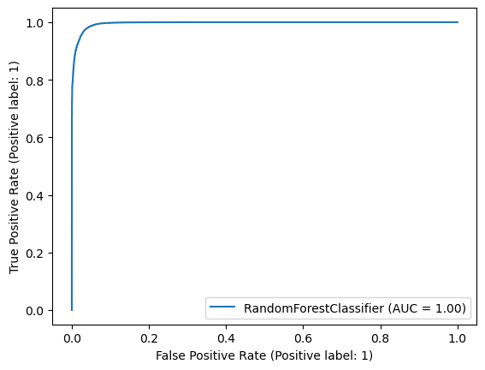
Random Forest
ROC curve using hyperparameter tunning
Insights:
With Random Forest, we are getting 94% accuracy

Slide 16
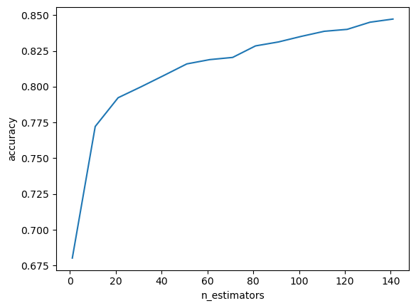
ADABOOST
Conclusion:
We will consider accuracy to check as giving an offer to an user not who going to churn will cost less as compared to loosing a customer and bring new customer, we need to have high rate of correctly identifying the true positives.
And as Random Foret and ADABOOST both have same accuracy of 94% but we will consider Random Forest as it is more robust.
Insights:
With ADABOOST, we are getting 94% accuracy.

Slide 17
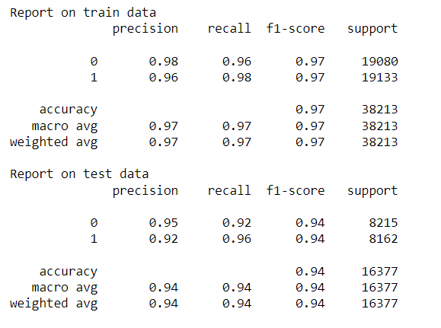
Final model

Slide 18
Suggestions to handle customer churn
Top 10 Predictors to handle customer churn
Some strategies to manage churns :
1. Churners show higher roaming usage than non churners.
2. Network operator should investigate their roaming tariffs and quality of services.
3. It may be a reason that roaming tariffs offered are less competitive than their competitors.
4. It may be a reason that customer is not getting good quality of services while roaming. In such case, quality of service guarantees with roaming partners and network quality needs to be investigated.
5. New campaigns that target roaming customers can be rolled out. Like
-Discounted roaming rates during particular hours of day
-Free monthly roaming on minutes of usage of voice calls depending on users past roaming usage history
loc_og_mou_8 1.282065
const 1.192894
total_rech_num_8 0.945401
monthly_3g_8 0.877368
monthly_2g_8 0.687312
gd_ph_loc_og_mou 0.649594
gd_ph_total_rech_num 0.632090
last_day_rch_amt_8 0.548943
std_ic_t2t_mou_8 0.517678
sachet_2g_8 0.441314
aon 0.39376

Slide 19
Thank You

